Slide 1


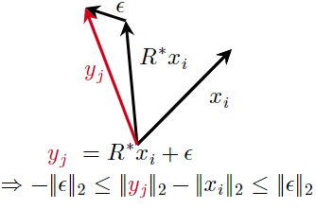
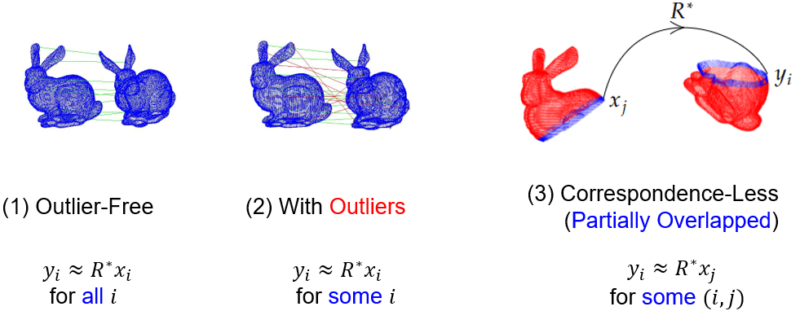
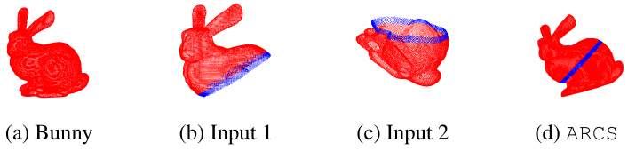
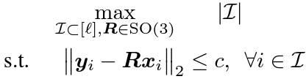
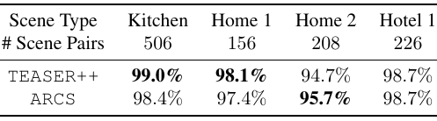
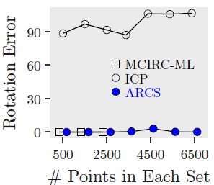
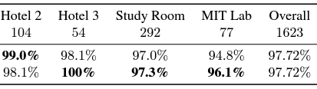
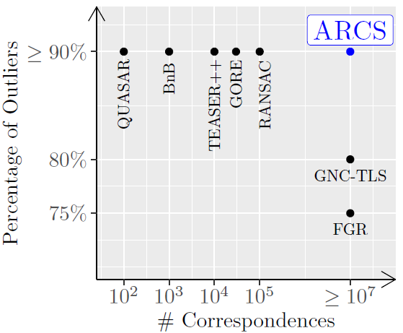
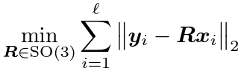
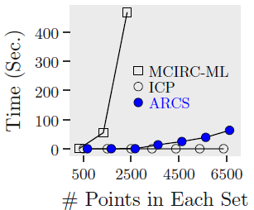
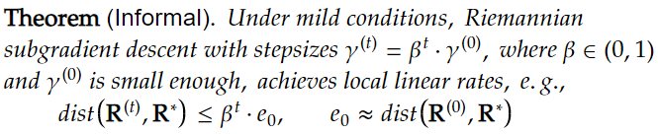



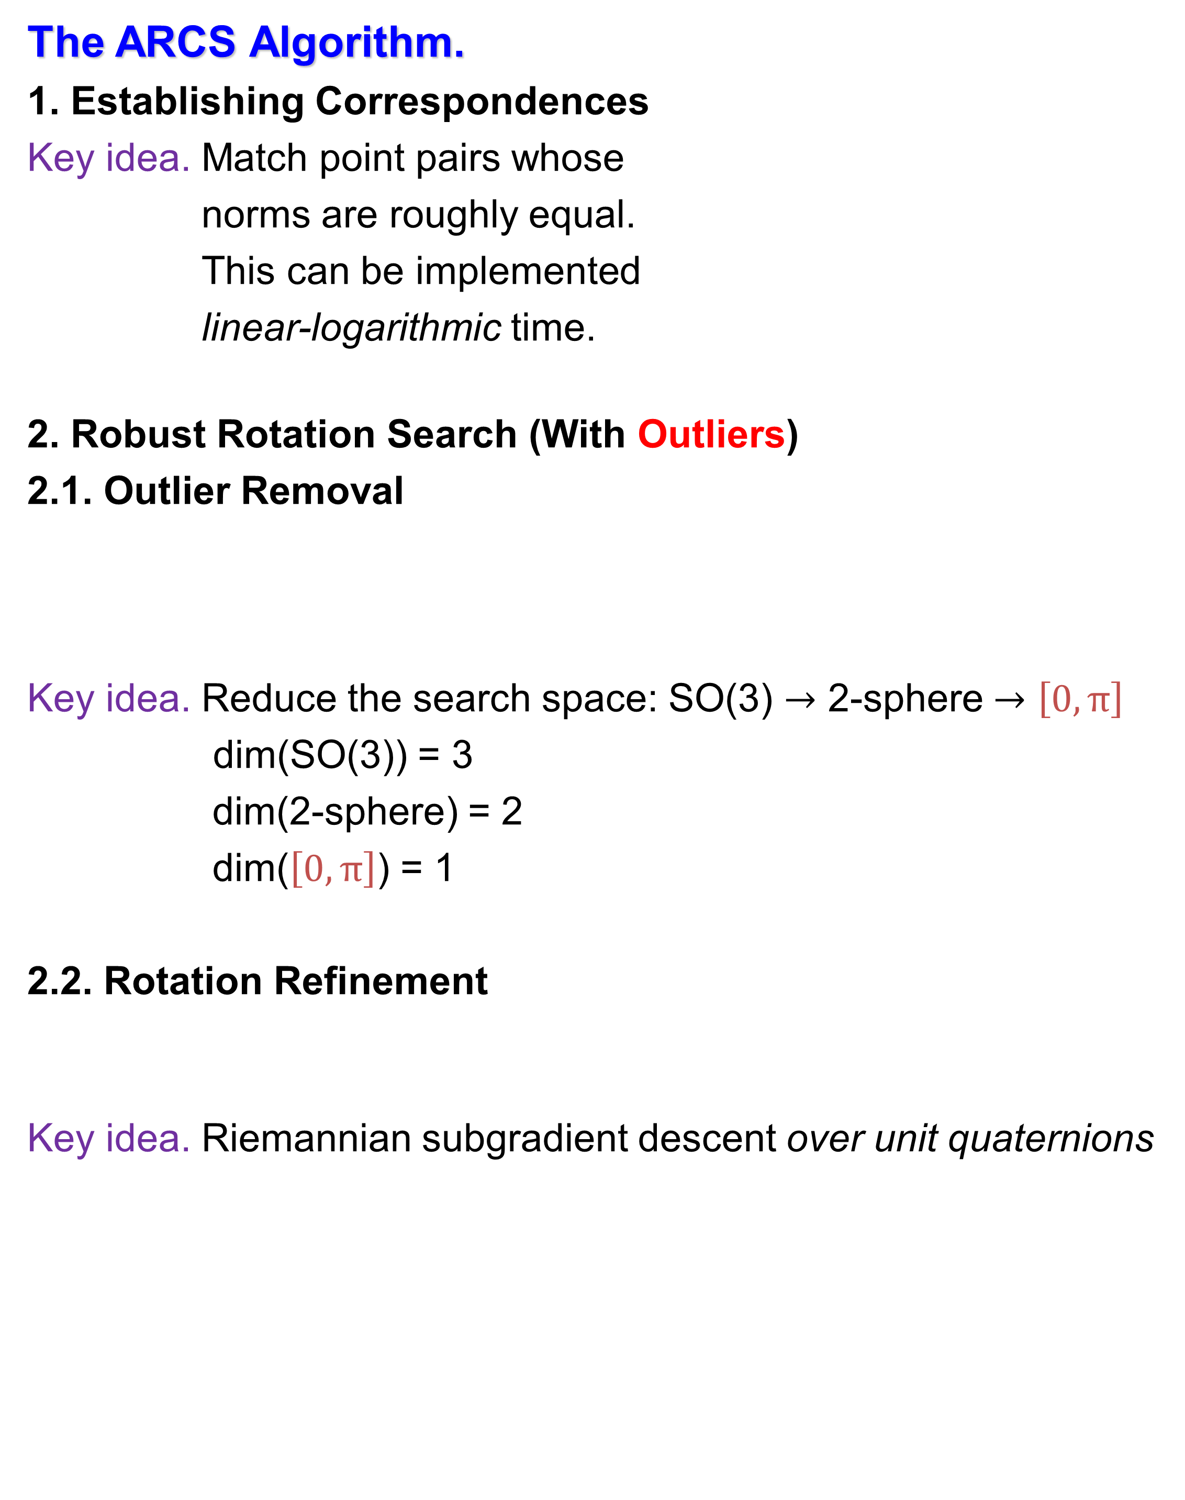
ARCS: Accurate Rotation and Correspondence Search Liangzu Peng, Manolis C. Tsakiris, Rene Vidal
Problem and Prior Art.
Problem: Find a 3D rotation $R^{∗}$ to “best” align two point clouds
Prior Art:
(2) With Outliers (3) Correspondence-Less
The ARCS Algorithm.
1. Establishing Correspondences
Key idea. Match point pairs whose
norms are roughly equal.
This can be implemented
linear-logarithmic time.
2. Robust Rotation Search (With Outliers)
2.1. Outlier Removal
Key idea. Reduce the search space: SO(3) $→$ 2-sphere $→$ $\left[0,π\right]$
dim(SO(3)) = 3
dim(2-sphere) = 2
dim($\left[0,π\right]$) = 1
2.2. Rotation Refinement
Key idea. Riemannian subgradient descent over unit quaternions
Experiments.
Experiment on Correspondence-Less Point Sets.
Experiment on the 3D Match dataset.
Metric: percentage of the time that error is less than ${10}^{°}$
Summary, Limitation, and Acknowledgement
Summary: Our ARCS algorithm can handle
$≥{10}^{7}$ correspondences at extreme outlier rates
$≈{10}^{4}$ correspondence-less points in both sets with $≈20\%$ overlaps
Limitation: ARCS is limited to the rotation-only case
Acknowledgement: This work was supported by NSF Grants 1704458 and 1934979, and by the Northrop Grumman Mission Systems Research in Applications for Learning Machines (REALM) initiative.

